Slide 1
PENALIZED REGRESSION MODEL

Slide 2
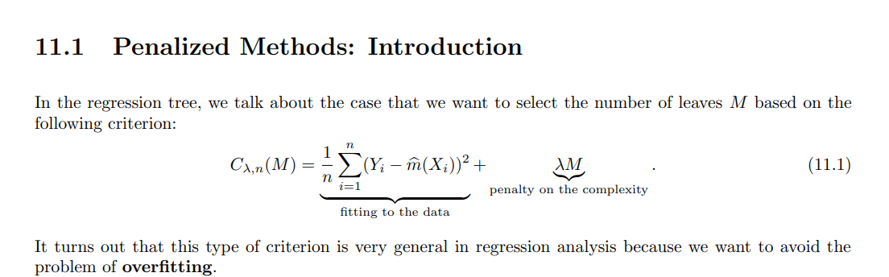
A Penalized model refers to a type of regression model that uses regularization techniques to reduce overfitting and improve generalization performance.

Slide 3
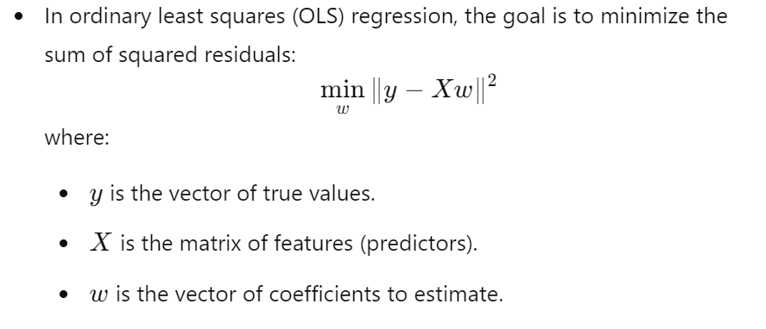

Slide 4
In penalized model , the loss function is modified to include an additional term known as the penalty term , which penalizes the model.
Common type of penalized models include
Lasso Regression (L1 regularization)
Ridge Regression(L2 regularization)
Elastic Net ( Combination of L1 and L2 Regularization)
Dropout (a regulariztion technique used in neural networks)

Slide 5
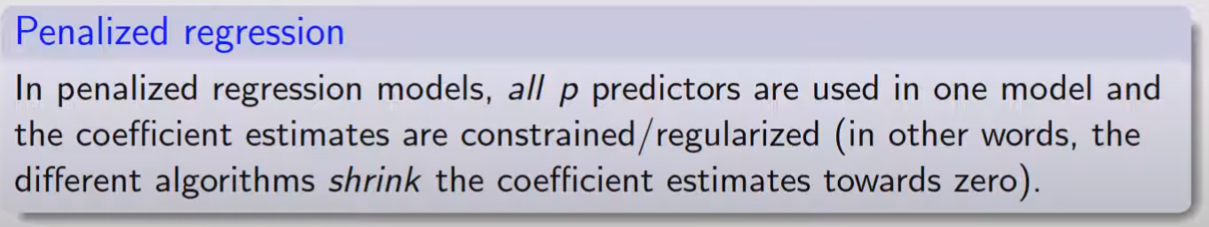

Slide 6
RIDGE REGRESSION
Ridge regression is a type of linear regression that addresses multicollinearity (when independent variables are highly correlated) by adding a penalty (regularization) term to the cost function.
This regularization discourages large coefficients in the model, making it more robust to overfitting, especially when dealing with complex or highly correlated data.

Slide 7
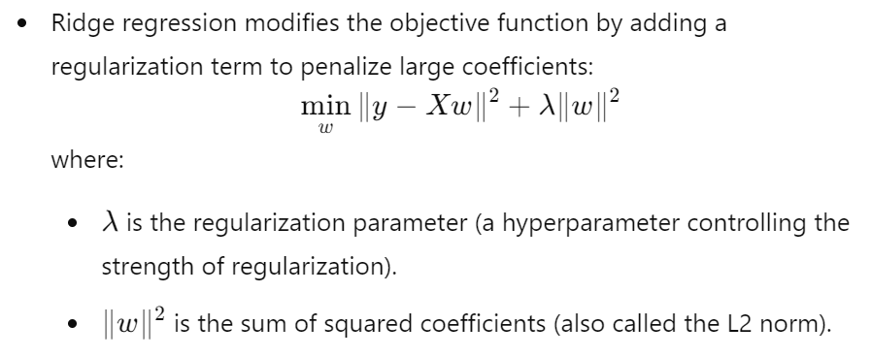

Slide 8
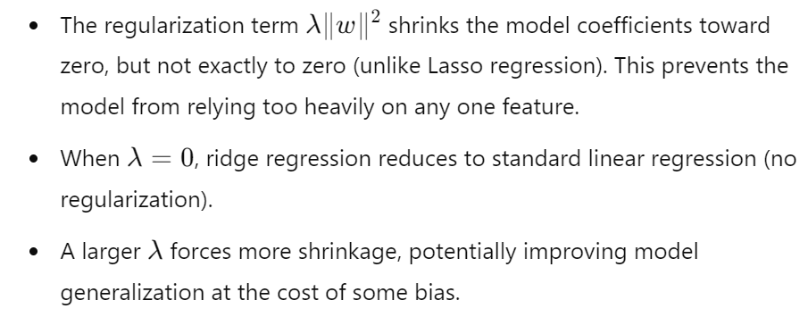
EFFECT OF RIDGE REGRESSION

Slide 9
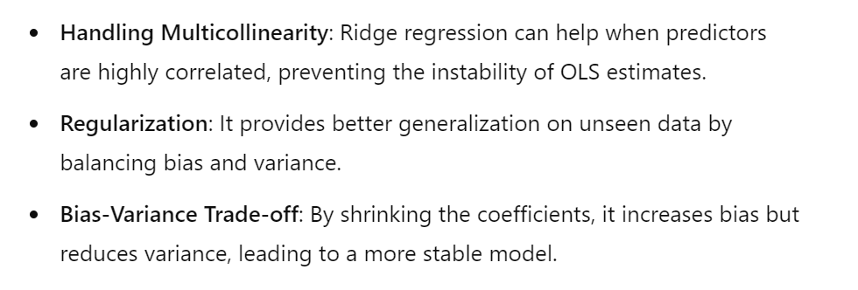
The value of λ is crucial for model performance. Cross-validation is often used to find the optimal λ that minimizes the prediction error.

Slide 10
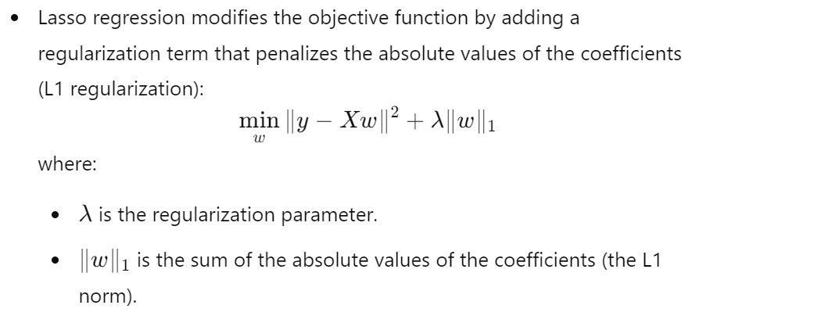
LASSO REGRESSION

Slide 11
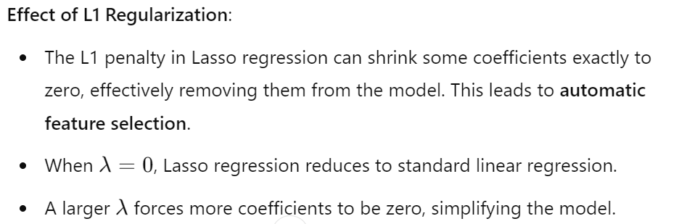

Slide 12
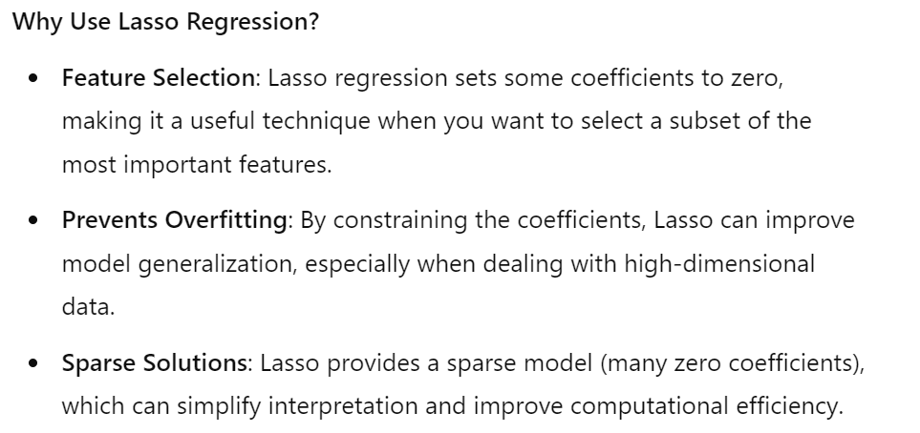

Slide 13
ELASTIC NET REGRESSION MODEL
Elastic Net regression is a regularized regression technique that combines the strengths of both Lasso (L1 regularization) and Ridge (L2 regularization).
It is useful when the dataset contains many features, especially when some features are correlated.
Elastic Net can both shrink coefficients (like Ridge) and perform variable selection (like Lasso), making it a robust choice for many predictive modeling problems.

Slide 14
